Slide 1

Designing a Chatbot
Done By:
Ngui Jia Le Sherlena

Slide 2
Contents
Project Problem Statement
Data Preparation
Model Selection
Model Training
Hyper-parameter tuning
Model Deployment
Performance Analysis

Slide 3

Project Problem Statement
How can we better help users which are unsure of how to book a trip for travelling to paranormal locations through the website

Slide 4
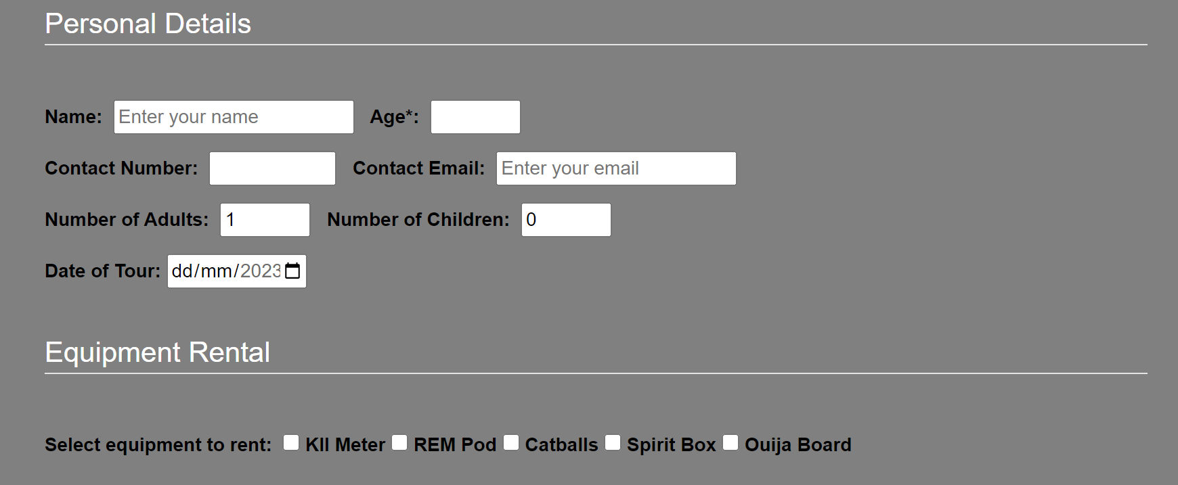
Data Preparation
Collection of data needed for booking
Collected Data about various Services for site
Noted Data Format of information

Slide 5

Model Selection
Deep Functionality
Flexible of Natural Language Understanding
Build Conversational Chatbots Quickly
Manages the Dialogue
Dynamically Adjusts the Responses in the Conversation
Amazon Lex

Slide 6

Model Selection
Supports Various Language
Can be used between services
Able to support multiple runs at the same time
Paid by Run Time
AWS Lambda

Slide 7

Model Selection
Object Storage Service
Able to host Static Website
Backed Up Regularly
Able to be integrated with AWS Lambda
Amazon Simple Storage Service (Amazon S3)

Slide 8
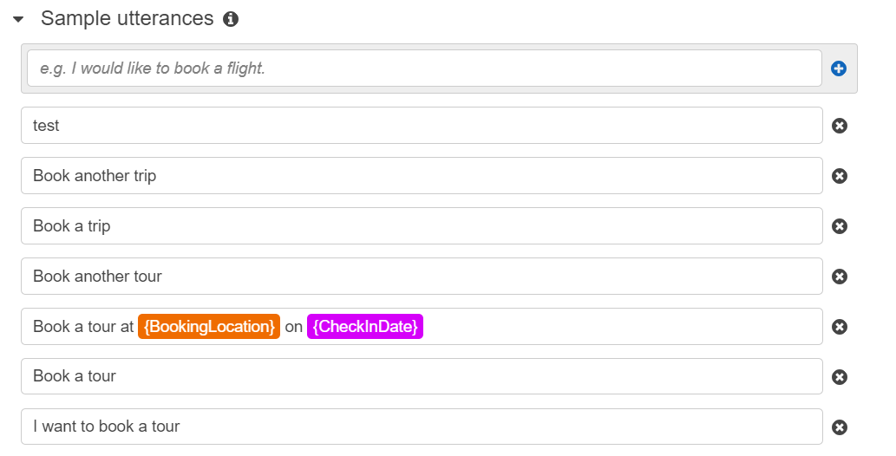
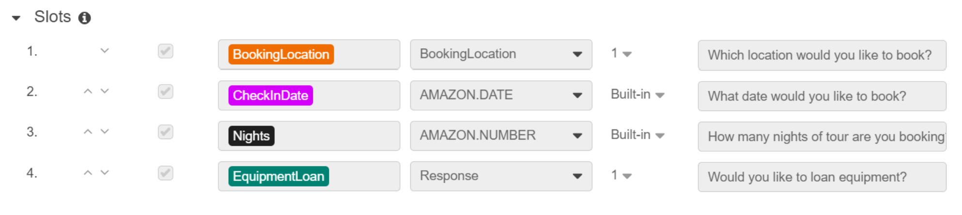
Model Training
Addition of Sample Utterances
Addition of various slots to ask

Slide 9
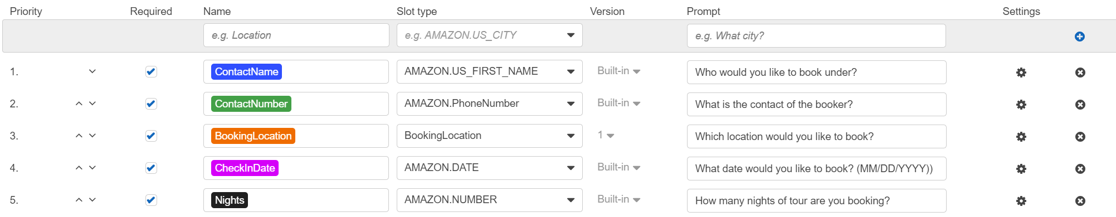
Hyper-parameter tuning
Addition of Contact Name
Addition of Contact Number
Added Formatting of Answers

Slide 10
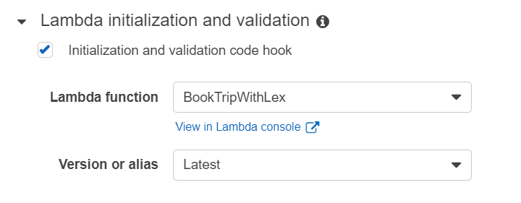
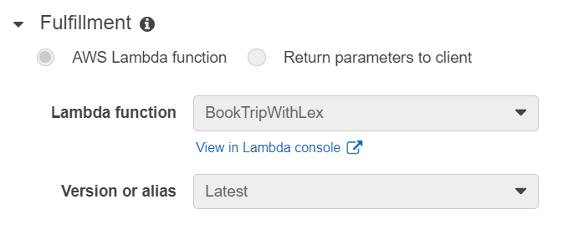
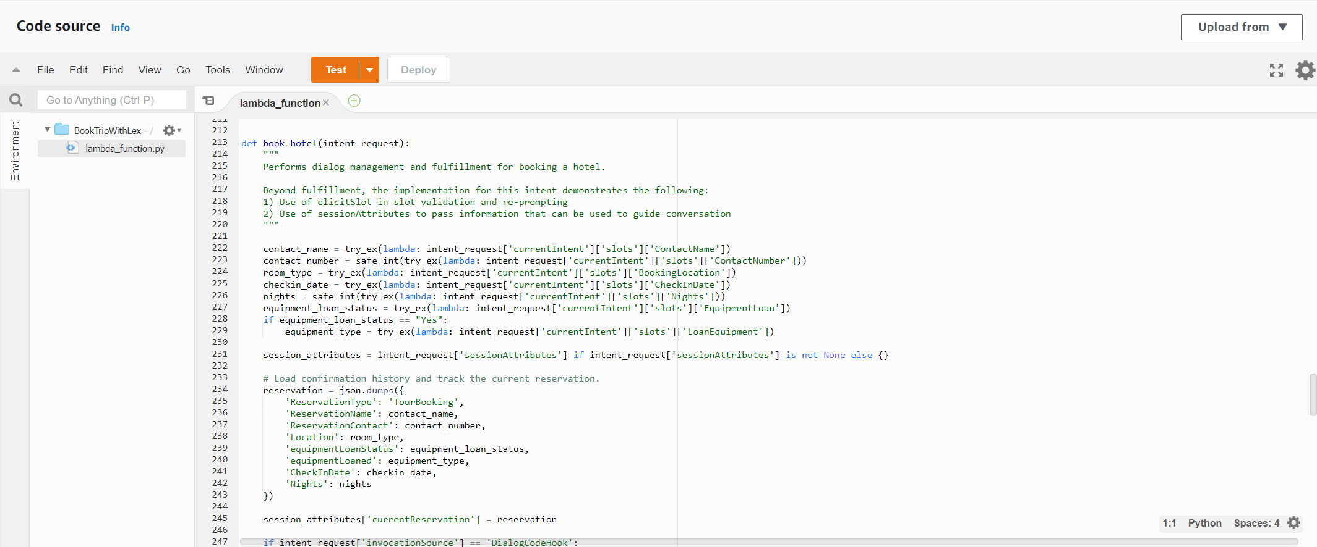
Model Deployment – Amazon Lex & AWS Lambda
Amazon Lex
Connected to AWS Lambda
AWS Lambda
Coded to validate input
Connected to Amazon Lex

Slide 11
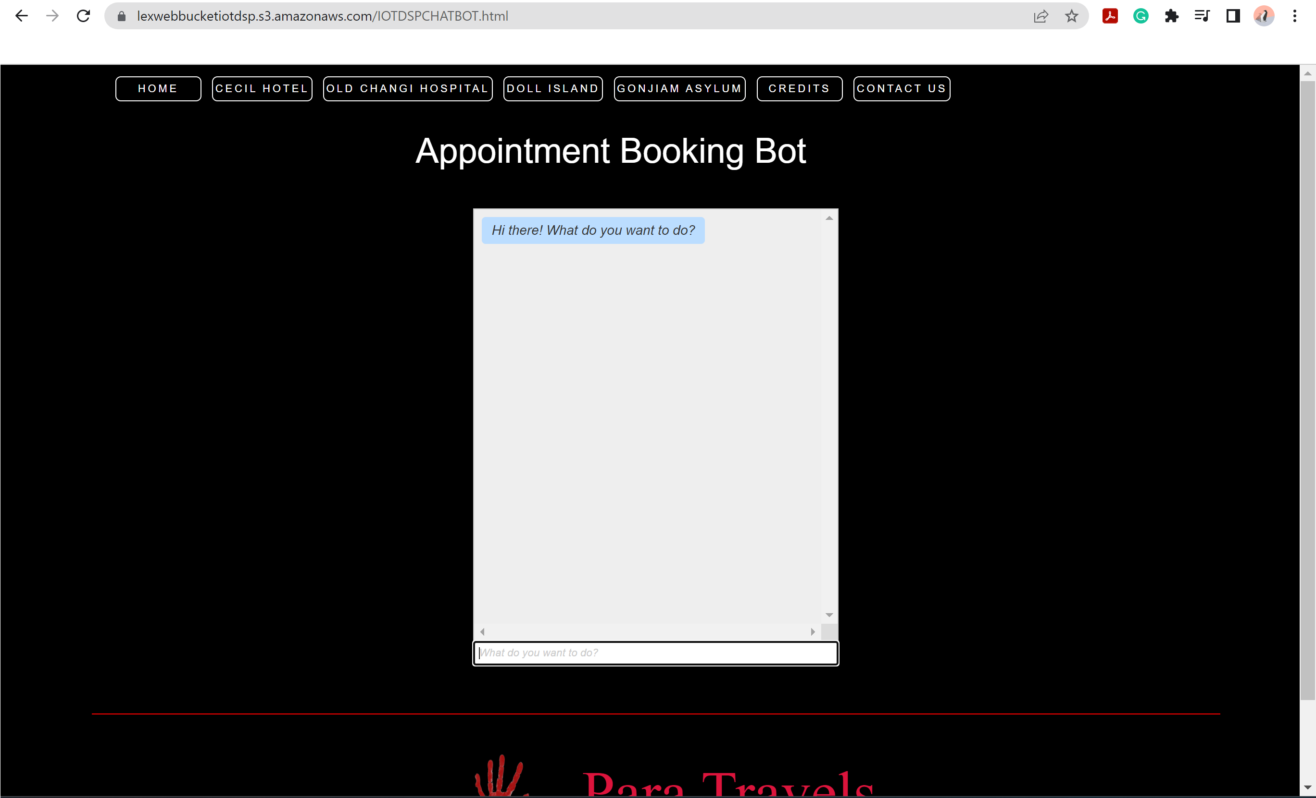
Model Deployment – S3 Bucket
Uploaded Resources to Bucket
Enabled Static Hosting
Specified
Index page
Custom error page
Addition to Website

Slide 12
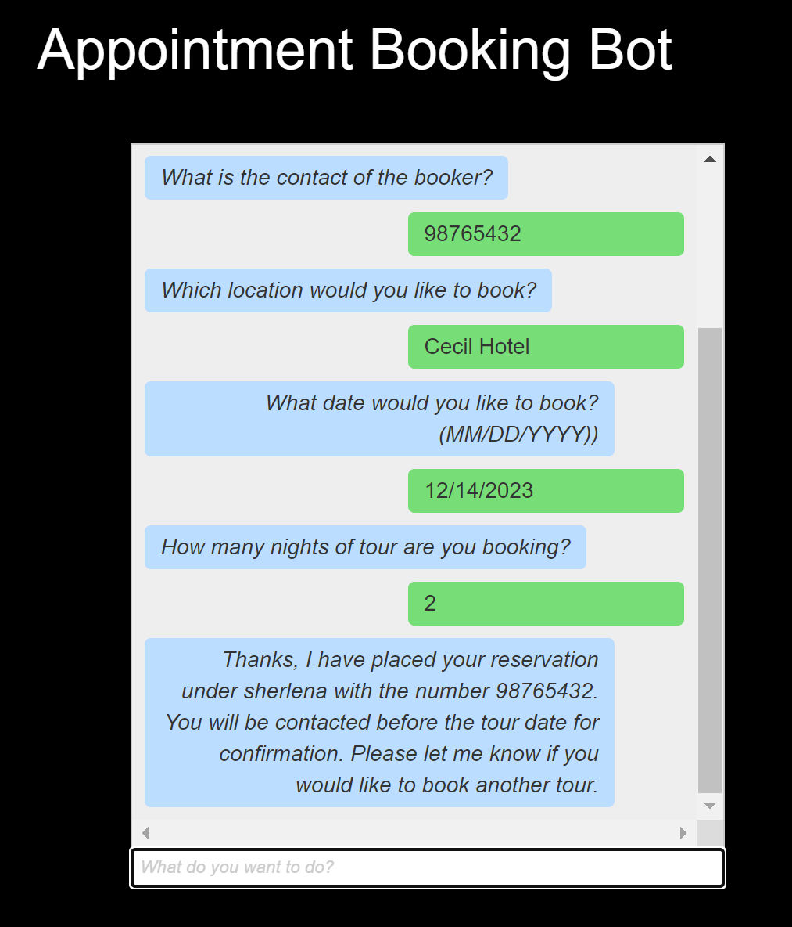
Performance Analysis
Issues with Input Validation
Able to book
Able to prompt appropriately

Slide 13
Thank You ☺

